Slide 1


Green Pace
Security Policy Presentation
Developer: Janera Dobson
CS-405-H4736 Secure Coding 21EW4

Slide 2

OVERVIEW: DEFENSE IN DEPTH
I was asked to present the Green Pace guide and to provide implementation guidelines and recommendations for maintaining it in the future. A security policy was needed to address security threats and implement strategies to mitigate vulnerabilities as well as how to recover them. Furthermore, the policies provide a guideline to employees on what to do and what not to do. Security policies would be used to support the defense-in-depth best practices because it aims to layer multiple defense mechanisms to the point of redundancy. Therefore, security policies would then become a multifaceted strategic plan when the DiD would be the next aspect of the defense.

Slide 3
THREATS MATRIX
SQL Injection: String data passed to complex subsystems may contain special characters that can trigger commands or actions, resulting in a software vulnerability. Memory Protection: Reading memory that has already been freed can lead to abnormal program termination and denial-of-service attacks. Exceptions: Throwing unexpected exceptions disrupts control flow and can cause premature termination and denial of service. Input/Output: Inputting and outputting from a stream without an intervening flush or positioning call is undefined behavior. Characters and Strings: Copying data to a buffer that is not large enough to hold that data results in a buffer overflow. | SQL Injection: String data passed to complex subsystems may contain special characters that can trigger commands or actions, resulting in a software vulnerability. Data Value: Integer truncation errors can lead to buffer overflows and the execution of arbitrary code by an attacker. Memory Protection: Reading memory that has already been freed can lead to abnormal program termination and denial-of-service attacks. Exceptions: Throwing unexpected exceptions disrupts control flow and can cause premature termination and denial of service. Containers: If two unrelated iterators (including pointers) are subtracted, the operation results in undefined behavior. Characters and Strings: Copying data to a buffer that is not large enough to hold that data results in a buffer overflow.
Data Type: Programmers are consequently more likely to directly manipulate the fields within the structure, violating the software engineering principles of information hiding and data encapsulation and increasing the probability of developing incorrect or nonportable code. String Correctness: The process of parsing an integer or floating-point number from a string can produce many errors. Assertion: Static assertion is a valuable diagnostic tool for finding and eliminating software defects that may result in vulnerabilities at compile time. | Data Type: Programmers are consequently more likely to directly manipulate the fields within the structure, violating the software engineering principles of information hiding and data encapsulation and increasing the probability of developing incorrect or nonportable code. String Correctness: The process of parsing an integer or floating-point number from a string can produce many errors. Assertion: Static assertion is a valuable diagnostic tool for finding and eliminating software defects that may result in vulnerabilities at compile time.

Slide 4
10 PRINCIPLES
Validate Input Data: Data Type, Data Value, String Correctness, Memory Protection, Assertion, Exceptions, Input Output, Containers, Characters and Strings.
Heed Compiler Warnings: Data Value, String Correctness, Exceptions, Input Output, Characters and Strings.
Architecture and Design for Security Policies: SQL Injections, Memory Protection, Assertion, Exception, Input Output, Containers, Characters and Strings.
Keep it Simple: Data Type , Data Value, String Correctness, SQL Injections, Memory Protection, Assertion, Exception, Input Output, Containers, Characters and Strings.
Default Deny:
Adhere to the Principle of Least Privilege:
Sanitize Data Sent to Other Systems: SQL Injections, Memory Protection, Assertion, Exception, Input Output, Characters and Strings.
Practice Defense in Depth: Data Type , Data Value, String Correctness, SQL Injections, Memory Protection, Assertion, Exception, Input Output, Containers, Characters and Strings.
Use Effective Quality Assurance Techniques: Data Type , Data Value, String Correctness, SQL Injections, Memory Protection, Assertion, Exception, Input Output, Containers, Characters and Strings.
Adopt a Secure Coding Standard: Data Type , Data Value, String Correctness, SQL Injections, Memory Protection, Assertion, Exception, Input Output, Containers, Characters and Strings.

Slide 5
CODING STANDARDS
My ranking of my vulnerabilities derived from the SEI CERT C++ Coding Standard. Each standard I selected had given me the exact Severity, Likelihood, Remediation Cost, Priority, and Level for each listed below.
Rule | Severity | Likelihood | Remediation Cost | Priority | Level
STD-001-CPP | High | Unlikely | Medium | High | 2
Data Type: STD-111-C | Low | Unlikely | High | P1 | L3
Data Value: STD-222-C | High | Probable | High | P6 | L2
String Correctness: STD-333-C | Medium | Unlikely | Medium | P4 | L3
SQL Injection: STD-444-C | High | Likely | Medium | P18 | L1
Memory Protection: STD-555-C | High | Likely | Medium | P18 | L1
Assertions: STD-666-C | Low | Unlikely | High | P1 | L3
Exceptions: STD-777-CPP | Low | Likely | Low | P9 | L2
Input Output: STD-888-CPP | Low | Likely | Medium | P6 | L2
Containers: STD-999-CPP | Medium | Probable | Medium | P8 | L2
Characters and Strings: STD-1010-CPP | High | Likely | Medium | P18 | L2

Slide 6
ENCRYPTION POLICIES
Encryption | Explain what it is and how and why the policy applies.
Encryption in rest | Designed to prevent the attacker from accessing the unencrypted data by ensuring the data is encrypted when on disk. The policy applies to encrypt data at the requisite times.
Encryption at flight | The process of encrypting data (scrambling readable text so it can be only read by the person who has the secret code or decryption key) while the data is being transmitted. The policy applies to provide data security for sensitive information.
Encryption in use | It’s a capability that lets you run your computation on encrypted data or run encrypted applications. The policy applies to protect information in transit between authentication from the requested system.

Slide 7
TRIPLE-A POLICIES
Triple-A Framework* | Explain what it is and how and why the policy applies.
Authentication | Provides a way of identifying a user, typically by having the user enter a valid username and valid password before access is granted. The policy applies to check a user’s credentials to see if it’s a match and if not, network access is denied to protect the system.
Authorization | The authorization process determines whether the user has the authority to issue such commands. Authorization policy applies to enforce certain policies such as determining what types or qualities of activities, resources, or services a user is permitted.
Accounting | Accounting measures the resources a user consumes during access. This can include the amount of system time or the amount of data a user has sent and/or received during a session. Accounting policy applies by logging session statistics and usage information and is used for authorization control, billing, trend analysis, resource utilization, and capacity planning activities.

Slide 8
Unit Testing
The coding vulnerability I chose to test was “Character and Strings”.
Noncompliant Code
This example shows how the input is unbounded causing the code to be vulnerable and result in a buffer overflow
#include <iostream> void f() { char buf[12]; std::cin >> buf; }

Slide 9
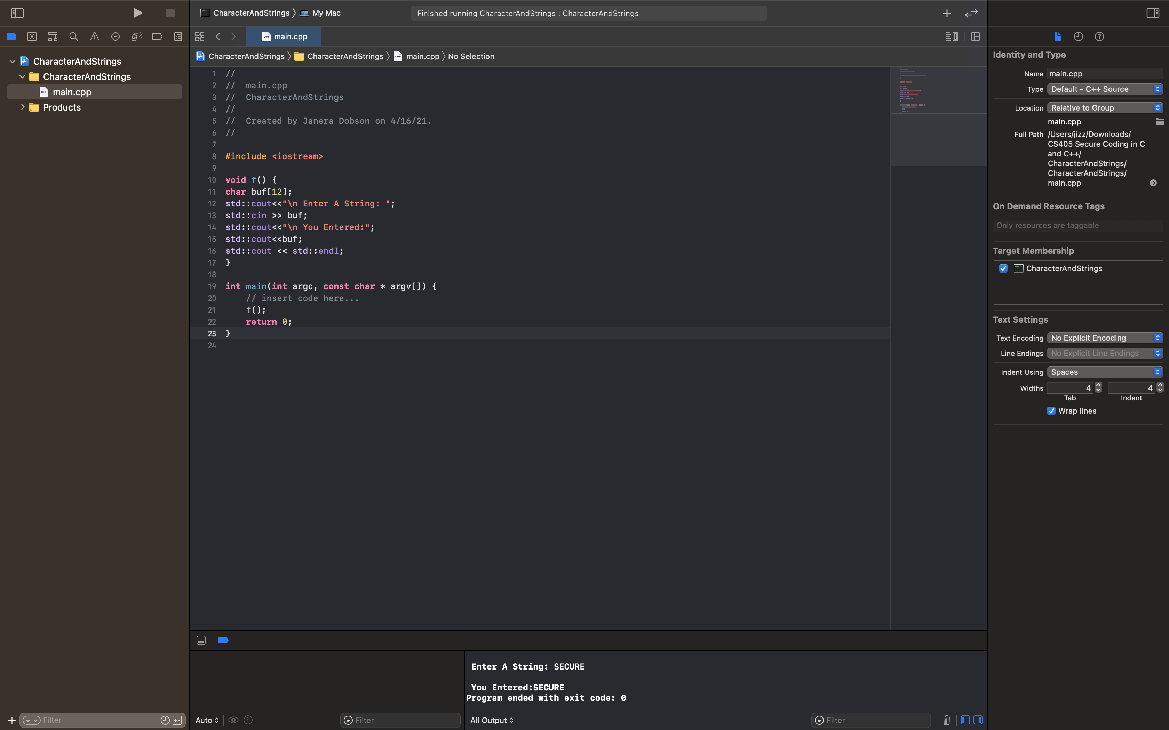
Would ”SECURE” be considered a valid length of Characters?
SECURE (Valid because Length of Characters is 6 which is within Limits i.e. 12 and No White Space)

Slide 10

Would ”SECURECODE” be considered a valid length of Characters?
SECURECODE (Valid because Length of Characters is 10 which is within Limits i.e. 12 and No White Space)

Slide 11

Would ”SECURE CODING” be considered a valid length of Characters?
SECURE CODING (Invalid because it contains White Space)

Slide 12
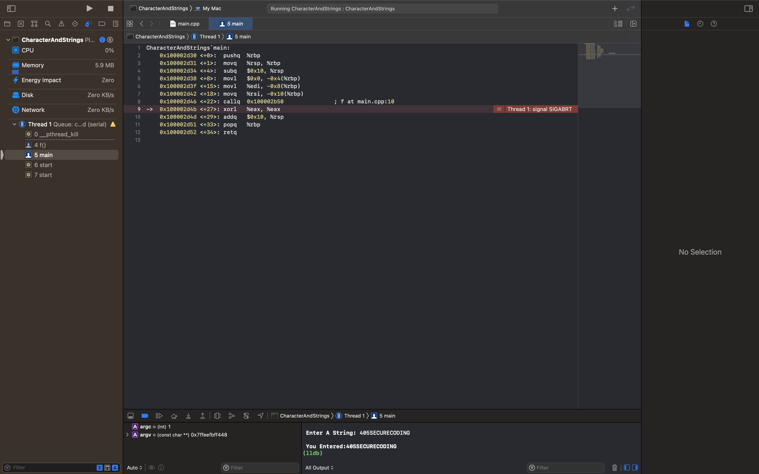
Would ”405SECURECODING” be considered a valid length of Characters?
405SECURECODING (Invalid because Length of Characters is 15 which is beyond Limits i.e. 12 )

Slide 13

AUTOMATION SUMMARY

Slide 14
TOOLS
DevSecOps aims to change that assumption. DevSecOps is a way of approaching IT security with an "everyone is responsible for security" mindset. It involves injecting security practices into an organization's DevOps pipeline. The goal is to incorporate security into all stages of the software development workflow. That's contradictory to its predecessor development models—DevSecOps means you're not saving security for the final stages of the SDLC. DevSecOps is based on the principle of DevOps, which will help your case for making the switch. And doing so will enable you to bring together proficient individuals from across different technical disciplines to enhance your existing security processes.
In DevSecOps, specific security checks are applied in each phase.
Plan: Execute security analysis and create a test plan to determine scenarios for where, how, and when testing will be done.
Code: Deploy linting tools and Git controls to secure passwords and API keys.
Build: While building code for execution, incorporate static application security testing (SAST) tools to track down flaws in code before deploying to production. These tools are specific to programming languages.
Test: Use dynamic application security testing (DAST) tools to test your application while in runtime. These tools can detect errors associated with user authentication, authorization, SQL injection, and API-related endpoints.
Release: Just before releasing the application, employ security analysis tools to perform thorough penetration testing and vulnerability scanning.
Deploy: After completing the above tests in runtime, send a secure build to production for final deployment.
Tools are available for every phase of the SDLC. Some are commercial products, but most are open source and paid testing tools available, which offer a variety of functionality and support for language ecosystems, including BDD Automated Security Tests, JBroFuzz, Boofuzz, OWASP ZAP, Arachi, IBM AppScan, GAUNTLT, and SecApp suite.

Slide 15
RISKS AND BENEFITS
Security testing has also historically added significant time to a schedule because it is traditionally a manual effort. Adding security tasks into a DevOps culture would then seem to be working against the goal of and reducing the effort it takes to release updates and new features. Operations teams moving to a DevOps culture faced a similar challenge when so many servers and applications were manually deployed. The solution for operations teams was to work toward automating these tasks to reduce the friction of software deployment. This automation eventually helped reduce cycle times.
Some types of security testing are also easily automated and much of it can be done in parallel with other project tasks. Static analysis security testing (SAST) can be run while code is being developed. You can also run automated dynamic analysis security testing (DAST) scans against applications in test or staging environments. You can even write automated tests for the security configuration of the infrastructure itself. While these automated scans will not replace all types of security testing that you may want to do, the effort does two things: 1) it improves the timeliness of feedback from security, and 2) it frees security staff up to tackle the harder problems. Furthermore, by automating these tasks, you also avoid inflating the schedule, continuing the focus on reducing cycle times.
Organizations can see a variety of benefits when adopting DevSecOps culture, practices, and integrating security early and throughout the project lifecycle. Businesses that successfully transform from DevOps to DevSecOps will see advantages such as a reduction of security-related rework, as well as find an increase in employee engagement with an improved security posture without impacting team agility and flexibility.

Slide 16
RECOMMENDATIONS
The developer knowledge gap: This knowledge gap is a barrier to any attempt to shift security left, so your DevSecOps strategy needs to address it using a combination of training.
Lack of AppSec tool integration: Developers need a consolidated view of issues, but combining and reconciling findings from multiple vendors’ tools can be difficult. This challenge is the motivation behind the design of Code Sight™, an IDE plugin that brings results from SAST and SCA together directly at the developer desktop.
Pipeline friction and developer overload: This lengthy, human-intensive model is incompatible with the high-velocity, integrated, and automated model of DevOps. And it makes clear that it’s not enough to build security into DevOps. You need to leverage AppSec tools that have DevOps built into them.

Slide 17
CONCLUSIONS
Positive Security: “Define what is allowed and reject everything else. This model, also called whitelisting, is the only true method of preventing unwanted attacks that weren’t thought of during development.”
Fail Securely: “Realize that failure is unavoidable, and your applications will fail – make sure you (and they) are prepared. Instead, we need to ensure our software is prepared to fail without offering up sensitive data in the process.”
Avoid Security by Obscurity: “Perhaps one of the best ways to avoid security by obscurity is to assume your source code has already been taken. That would be a worst-case scenario, but we can’t keep holding our fingers crossed hoping a vulnerability won’t be discovered before you can fix it.”

Slide 18
REFERENCES
Schiela, R. (2020, May 20). SEI CERT C++ Coding Standard. Retrieved 2021, from https://wiki.sei.cmu.edu/confluence/pages/viewpage.action?pageId=88046682.
Schiela, R. (2018, May 02). Top 10 Secure Coding Practices. Retrieved 2021, from https://wiki.sei.cmu.edu/confluence/display/seccode/Top+10+Secure+Coding+Practices.
Vonnegut, S. (2015, July 1). 9 secure coding practices you CAN'T IGNORE. Retrieved 2021, from https://www.checkmarx.com/blog/9-secure-coding-practices-you-cant-ignore/.
Vijayan, J. (2019, December 31). 6 DevSecOps best practices: Automate early and often. Retrieved 2021, from https://techbeacon.com/security/6-devsecops-best-practices-automate-early-often.
Devsecops: A complete guide to what, why, and how. (2021, March 30). Retrieved April 18, 2021, from https://www.plutora.com/blog/devsecops-guide.

